Slide 1
Introductory Java and FTC Programming Workshop
Week 3 - Operations and Methods (Nov. 14)
Hanson Chan
Notes:
Hello Everyone! Welcome to my workshop for Introductory Java and FTC Programming. Before I begin, I would like to thank you all for coming, and Esquimalt High School for hosting.

Slide 2
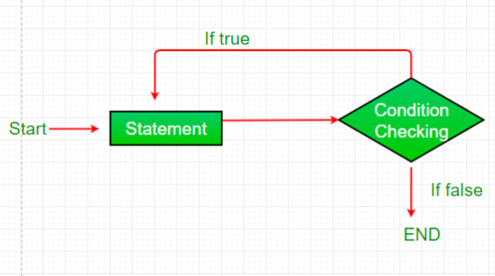
Which loop is this?
Definite loops
For loops
Indefinite loops
While Loops
Do While loops
Notes:
Do While Loop

Slide 3
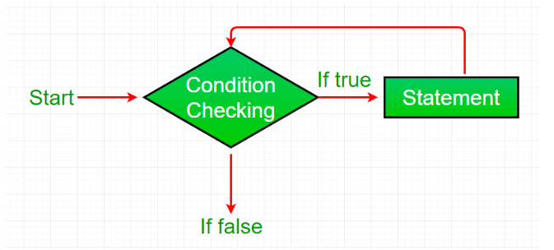
Which loop is this?
Definite loops
For loops
Indefinite loops
While Loops
Do While loops
Notes:
While Loop

Slide 4
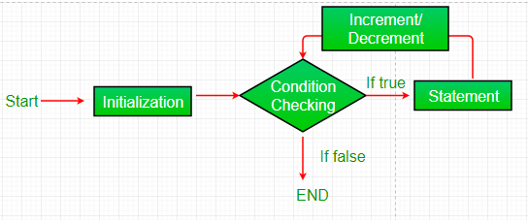
Which loop is this?
Definite loops
For loops
Indefinite loops
While Loops
Do While loops
Notes:
For loop

Slide 5
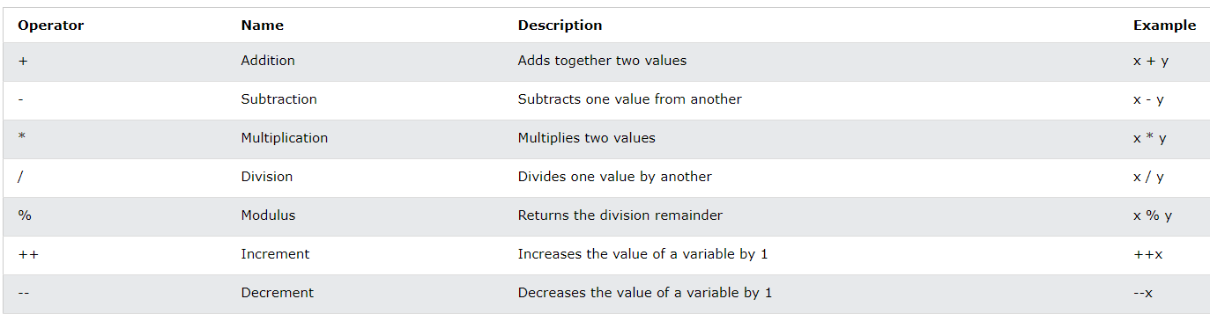
Arithmetic Operations

Slide 6

Assignment Operator

Slide 7
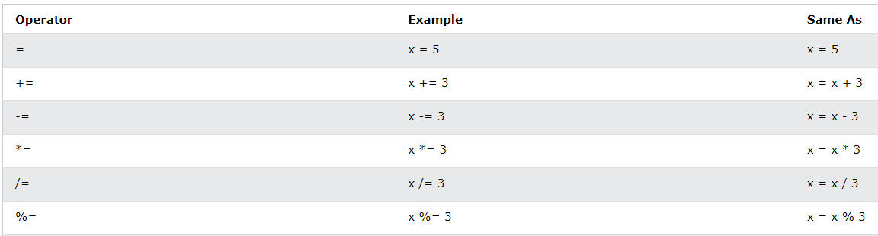
Assignment Operator (Cont.)

Slide 8

Comparison Operator

Slide 9
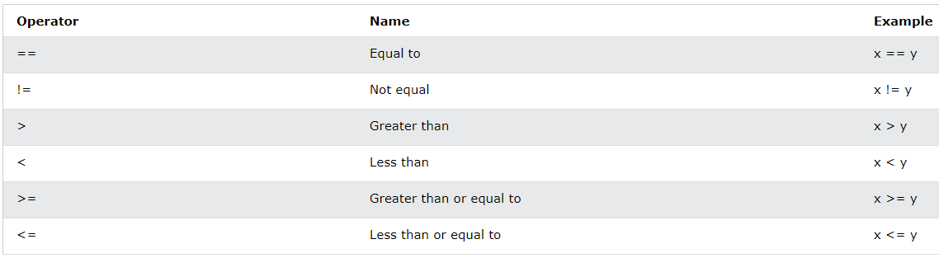
Comparison Operator (Cont.)

Slide 10
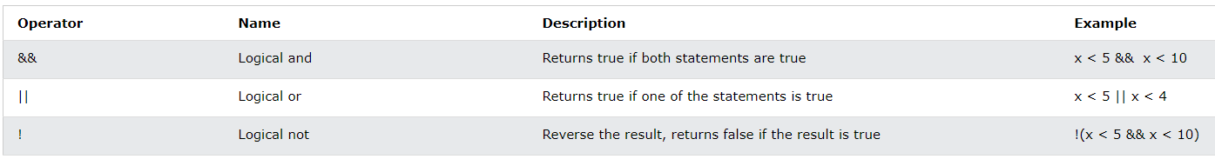
Logical Operators

Slide 11
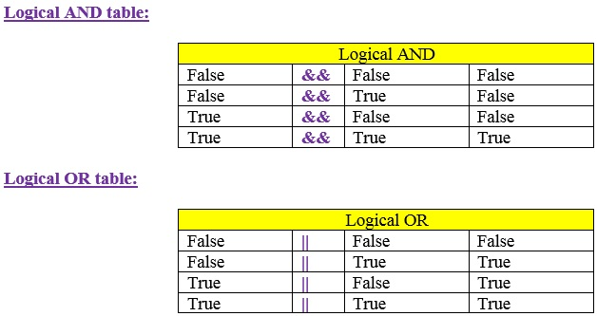
Logical Operators (Cont.)

Slide 12
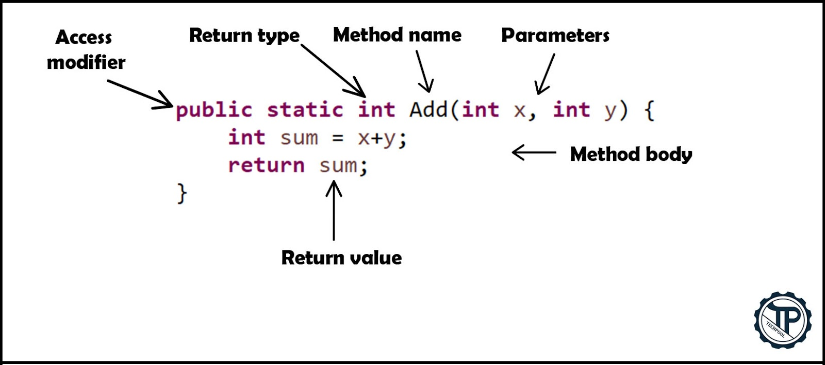
Methods!

